Slide 1
The Technology Value Stream Understanding Lead Time and Processing Time
Roald Medendorp
1/5/2025
CSD 380

Slide 2
Introduction to Technology Value Stream
Definition of Technology Value Stream
The sequence of activities necessary to deliver a product, service or experience to a customer, internal or external.
Importance in software development and operation efficiency
provides a holistic view of the entire process involved in delivering a technology product or service to a customer, allowing organizations to identify bottlenecks, eliminate waste, optimize workflows, and ultimately deliver more value to customers faster by streamlining the entire process from conception to delivery, leading to improved efficiency, reduced costs, and increased customer satisfaction; essentially, it helps businesses understand where to focus improvement efforts to maximize the value created by their technology operations.

Slide 3
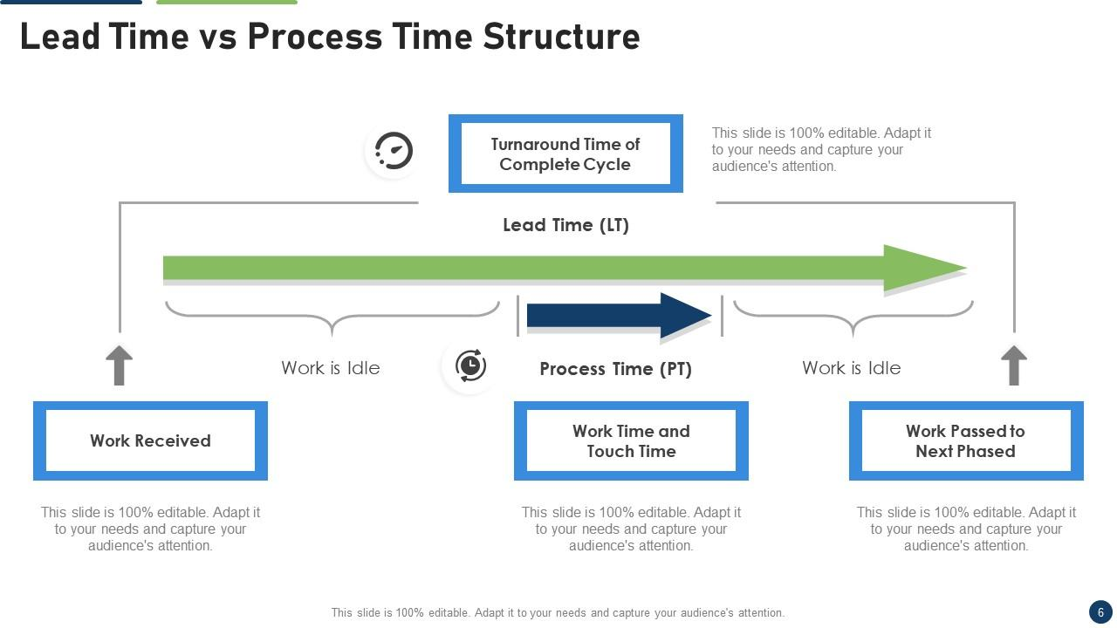
Lead Time vs. Processing Time
Lead Time: Total time from idea to delivery.
Processing Time: Actual time spent working on the task.

Slide 4
The Common Scenario: Long Deployment Lead Times
Overview of deployment lead times often extending to months.
Key factors contributing to long lead times, like complex approvals and bottlenecks.

Slide 5
Impact of Extended Lead Times
Extended lead times within a technology value stream can significantly impact a company's operations by causing increased inventory costs, reduced customer satisfaction, lower productivity, and potential delays in product launches

Slide 6
Our DevOps Ideal: Short Deployment Lead Times
Implementing advanced technologies like automation or AI can help speed up processes and reduce lead times.
Benefits of achieving short deployment times: Faster feedback, higher quality products, and improved team satisfaction.

Slide 7
Key Practices to Achieve Short Deployment Times
Continuous Integration/Continuous Deployment (CI/CD)
Automation of testing and deployment processes
Fostering a DevOps culture

Slide 8
Conclusion
Understanding the Technology Value Stream is crucial for enhancing efficiency in software development processes. Distinguishing between lead time—the total duration from idea to delivery—and processing time—the actual working time on tasks—enables teams to identify areas for improvement. The common scenario of lengthy deployment lead times, which can extend to months, highlights the need for streamlined processes. Conversely, the DevOps ideal advocates for dramatically reduced deployment times of mere minutes, fostering rapid delivery and continuous feedback. Embracing these principles not only optimizes the technology value stream but also contributes to improved project outcomes and team morale.

Slide 9
References
Value stream management
https://www.techtarget.com/searchcio/definition/value-stream-management
What is lead time in Value Stream Mapping?
https://miro.com/value-stream-mapping/what-is-lead-time/
What is Value Stream Management (VSM) and Why is it Important?
https://www.atlassian.com/agile/value-stream-management

